Slide 1
AI/ML for Android (Special topic)
Info5126 :
Mobile Development Advanced

Slide 2
AI and ML on Android Phones
You can deliver AI and ML features either on your device or using the cloud
On-device solutions like Gemini Nano deliver results with no additional cost, provide enhanced user privacy, and provide reliable offline functionality because input data is processed locally. These benefits can be critical for certain use cases, like message summarization, making on-device a priority when choosing the right solutions.

Slide 3
Gemini Nano
Gemini Nano lets you run inference directly on an Android-powered device. If you're working with text or images, start with ML Kit's GenAI APIs for out-of-the-box solutions. The ML Kit GenAI APIs are powered by Gemini Nano and fine-tuned for specific on-device tasks. The ML Kit GenAI APIs are an ideal path to production for your apps due to their higher-level interface and scalability. These APIs allow you to implement use-cases to summarize, proofread, and rewrite text, as well as generate image descriptions.

Slide 4
Gemini Nano Exerimental Access for customized use cases
To move beyond the fundamental use cases provided by
the ML Kit GenAI APIs, consider Gemini Nano Experimental Access. Gemini Nano Experimental Access gives you more direct access to custom prompting with Gemini Nano.

Slide 5
Custom Models
For traditional machine learning tasks, you have the flexibility to implement your own custom models. We provide robust tools like ML Kit, MediaPipe, LiteRT, and Google Play delivery features to streamline your development process.
For applications that require highly specialized solutions, you can use your own custom model, such as Gemma or another model that is tailored to your specific use case. Run your model directly on the user's device with LiteRT, which provides pre-designed model architectures for optimized performance.

Slide 6
ML Kit
ML Kit offers production-ready, mobile-optimized solutions for common machine learning tasks, requiring no prior ML expertise. This easy-to-use mobile SDK brings Google's ML expertise directly to your Android and iOS apps, allowing you to focus on feature development instead of model training and optimization. ML Kit provides prebuilt APIs and ready-to-use models for features like barcode scanning, text recognition (OCR), face detection, image labeling, object detection and tracking, language identification, and smart reply. TensorFlow Lite models.

Slide 7
ML Kit Introduction
These models are typically optimized for on-device execution, ensuring low latency, offline functionality, and enhanced user privacy as data often remains on the device. Choose ML Kit to quickly add established ML features to your mobile app without needing to train models or require generative output. It's ideal for efficiently enhancing apps with "smart" capabilities using Google's optimized models or by deploying custom TensorFlow Lite models.

Slide 8
On Device or Cloud
Connectivity vs offline functionality
Data privacy
Model capabilities and task complexity
Cost considerations
Device resources
Fine tuning and customization
Cross-platform consistency

Slide 9
Guide to AI/ML solutions
What is the primary goal of the AI feature?
A) Generating new content (text, image descriptions), or performing simple text processing (summarizing, proofreading, or rewriting text)? → Go to Generative AI
B) Analyzing existing data/input for prediction, classification, detection, understanding patterns, or processing real-time streams (like video/audio)? → Go to Traditional ML & Perception

Slide 10
ML Kit – Simplest to use
A) Need quick integration of pre-built, common mobile ML features? (e.g., barcode scanning, text recognition (OCR), face detection, image labeling, object detection and tracking, language ID, basic smart reply)
→ Use: ML Kit (Traditional APIs)
Why: Easiest integration for established mobile ML tasks, often optimized for on-device use (low latency, offline, privacy).

Slide 11
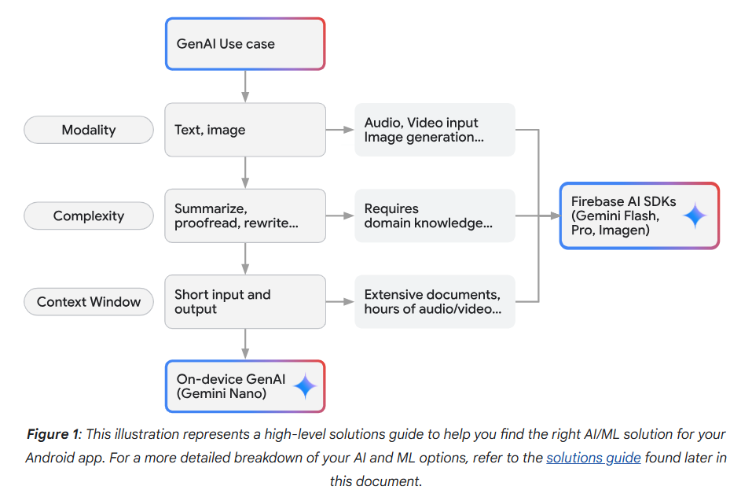
Finding the right solution

Slide 12
Link to AI and ML-Kit overview
https://developer.android.com/ai/overview
https://developers.google.com/ml-kit

Slide 13
Text Recognition v2
https://developers.google.com/ml-kit/vision/text-recognition
The ML Kit Text Recognition v2 API can recognize text in different languages. It can also be use to automate data entry such as processing credit cards, receipts and business cards
Detects text in images or videos

Slide 14
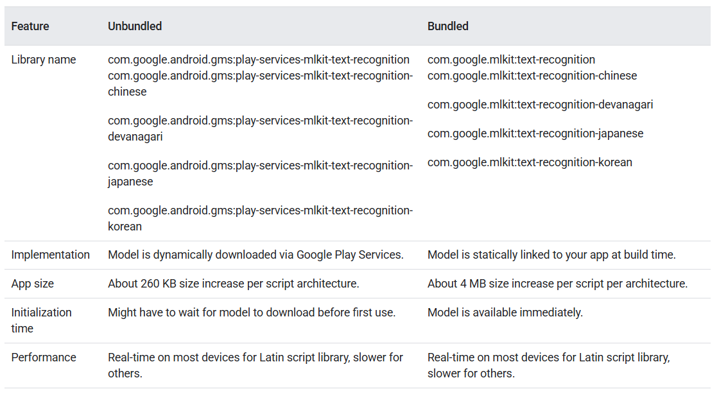
OCR API is available unbundled or bundled
Note: unbundled must be downloaded before use and bundled increases the app size

Slide 15
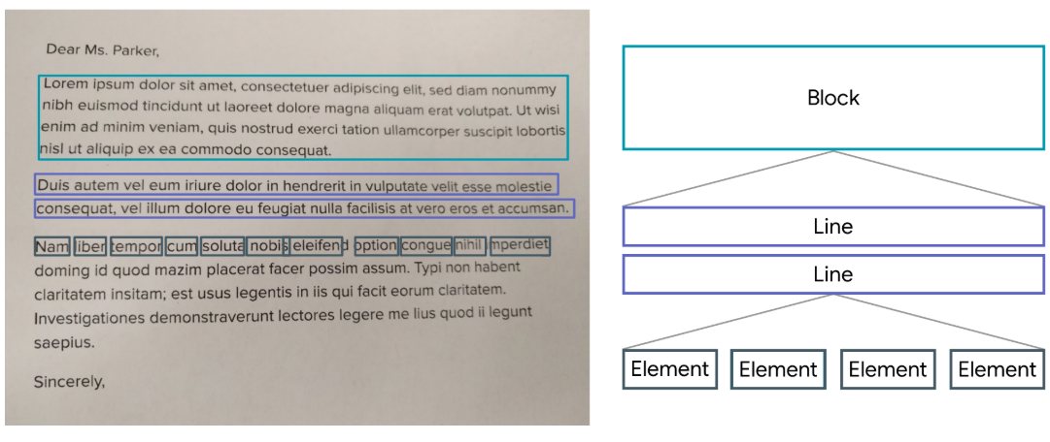
Text Structure

Slide 16
OCR Android Studio Setup
Project level build.gradle file to import the appropriate dependency (bundled or unbundled)
Android Manifest file
If choosing unbundled, you can set the meta-data for this application to download the dependency upon download. If you don’t set this, the douwnload will happen the first time you run the scanner.

Slide 17
OCR Code behind
Create an instance of the TextRecognizer
Prepare the input image
Process the image
Extract Text from blocks of recognized text

Slide 18
Link to Codelab for Text Recognition
Codelab for Recognizing Text and Facial features
https://codelabs.developers.google.com/codelabs/mlkit-android

Slide 19
Barcode Scanner
https://developers.google.com/ml-kit/vision/barcode-scanning/code-scanner
https://developers.google.com/ml-kit/vision/barcode-scanning/android

Slide 20
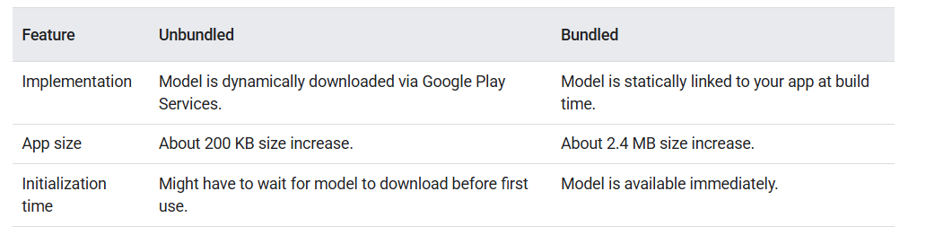
Barcode API is available unbundled or bundled

Slide 21
Barcode Android Studio Setup
Project level build.gradle file to import the appropriate dependency (bundled or unbundled)
Android Manifest file
If choosing unbundled, you can set the meta-data for this application to download the dependency upon download. If you don’t set this, the douwnload will happen the first time you run the scanner.

Slide 22
Barcode Code behind
Configure the Barcode Scanner
Prepare the input image
Get an instance of BarcodeScanner
Process the image
Get information from barcodes

Slide 23
Tips: Use of camera
In the demo we used images from the assets folder. However if you are using the phone camera to get the image, you may need to deal with the image orientation based on metadata (e.g. using Exif information) to ensure that the text is correctly oriented during recognition.

